Slide 1
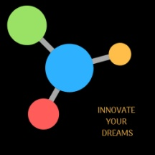
THIS WEEK WE'VE BEEN THINKING
A LOT ABOUT THE FUTURE.

Slide 2
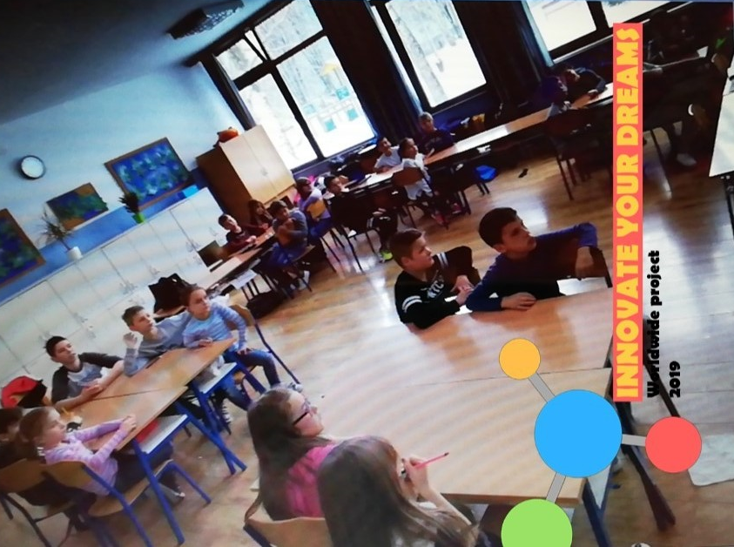

Slide 3
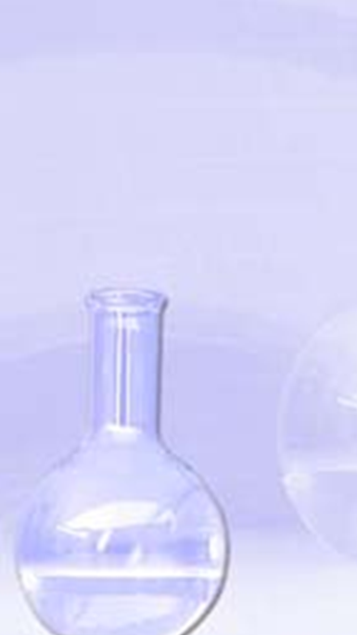
AMONG OTHER THINGS, WE WANTED TO BE ...

Slide 4
… CHEMISTS OF THE FUTURE.

Slide 5
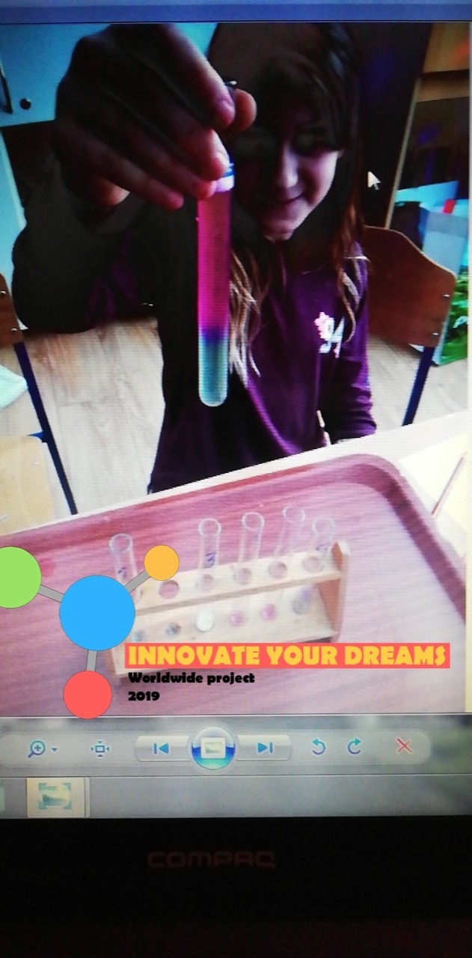
SO, WE PLAYED A LITTLE…

Slide 6
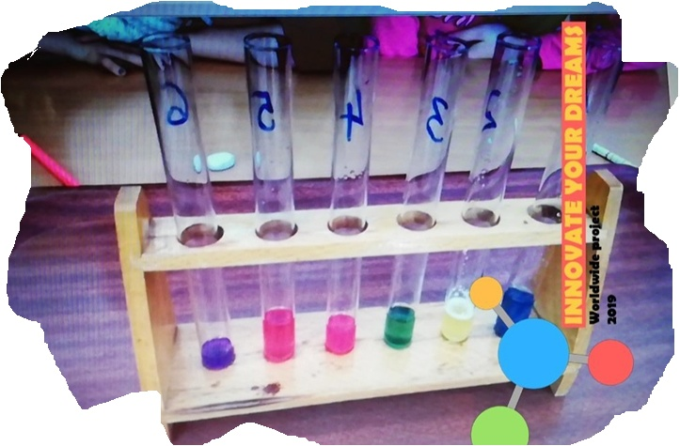

Slide 7
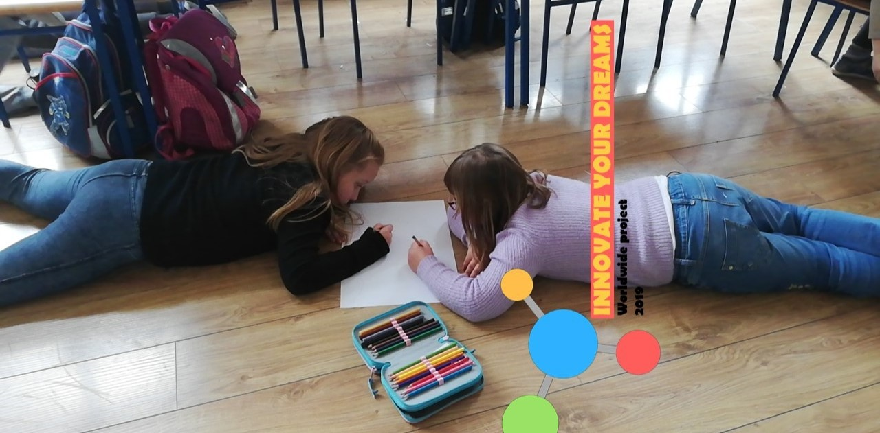
WE WERE THINKING A LITTLE …

Slide 8
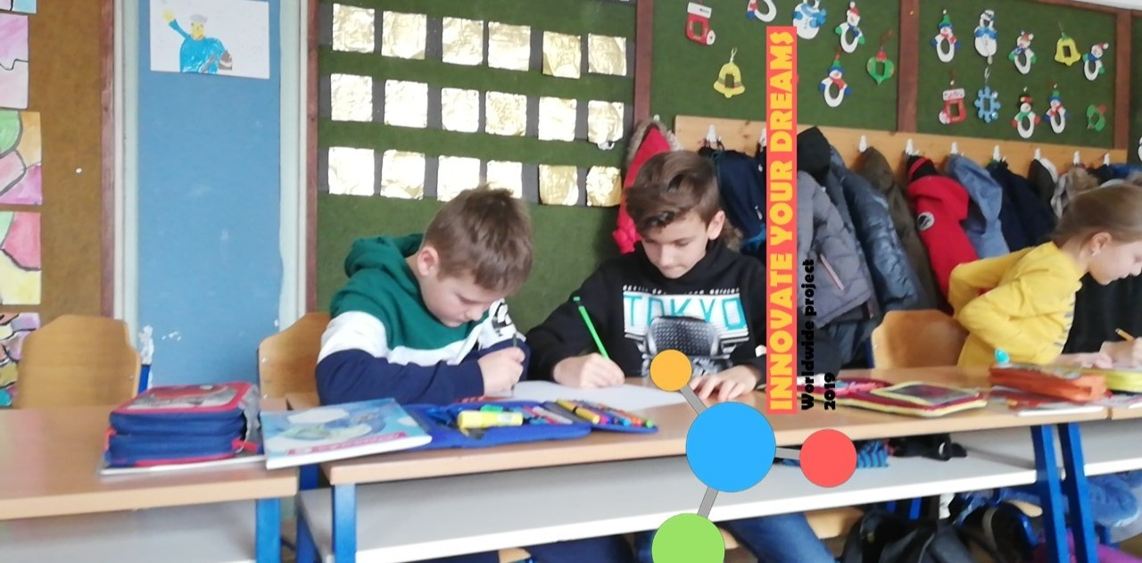

Slide 9
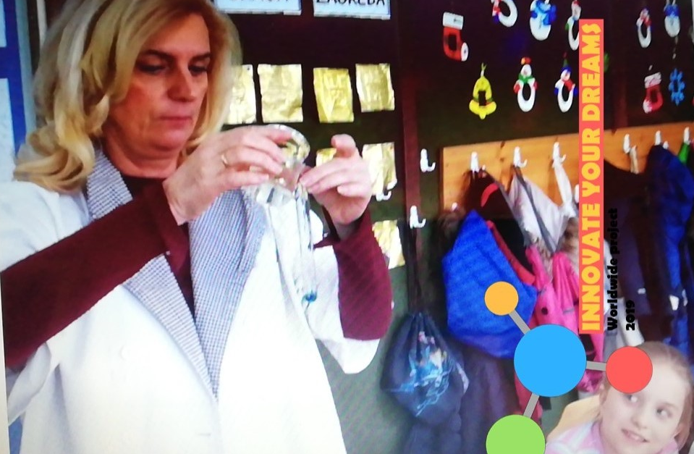
MIXING A LITTLE…

Slide 10
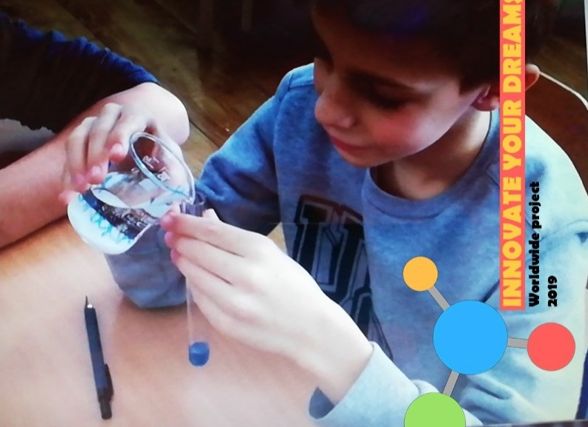

Slide 11
AT THE END, WE THOUGHT OF NEW OCCUPATIONS THAT WE WOULD LIKE TO DO WHEN WE GROW UP.

Slide 12
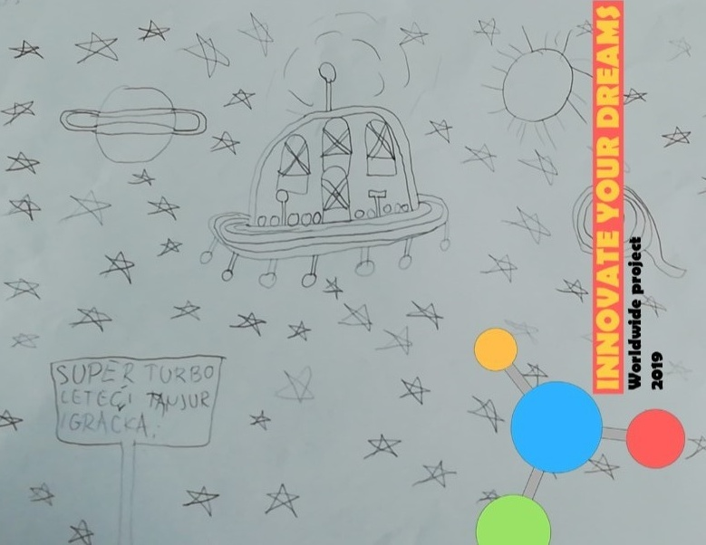
ORGANIZE DELIVERY GAMES WITH DRONE

Slide 13
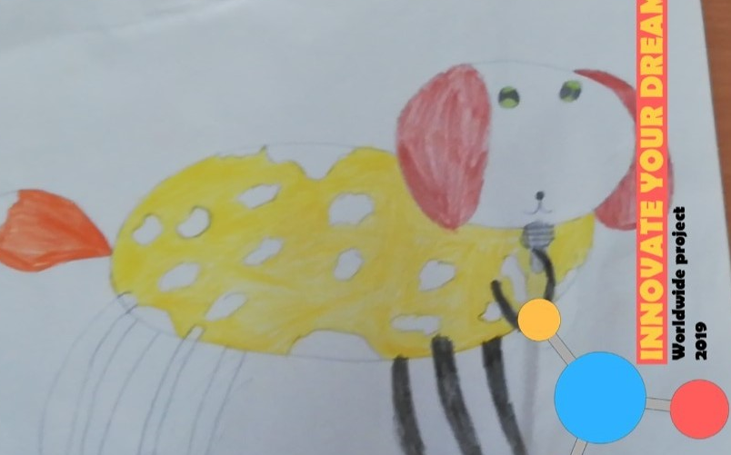
TRANSLATION FROM AN ANIMAL LANGUAGE TO HUMAN.

Slide 14
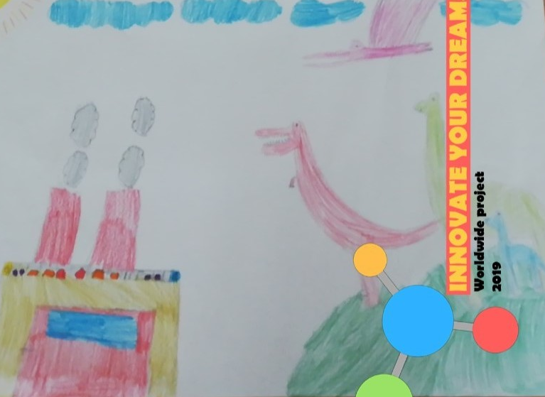
HELPING CHILDREN WITH PLAYING
VIRTUAL REALITY

